Slide 1
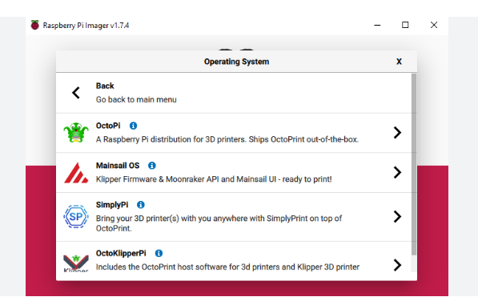
Install mainsailos on raspberry 4 with raspberry imager, SD card.
Set wifi and password etc

Slide 2
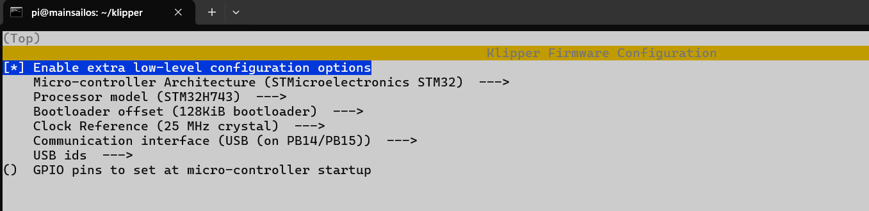
ssh pi@mainsailos.local
cd klipper
make menuconfig
Make -> klipper.bin

Slide 3
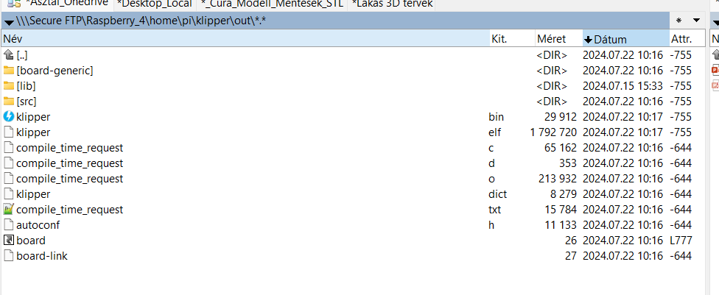
Rename Klipper.bin to firmware.bin and copy SD card ->power on SKR3
Get firmware.cur

Slide 4
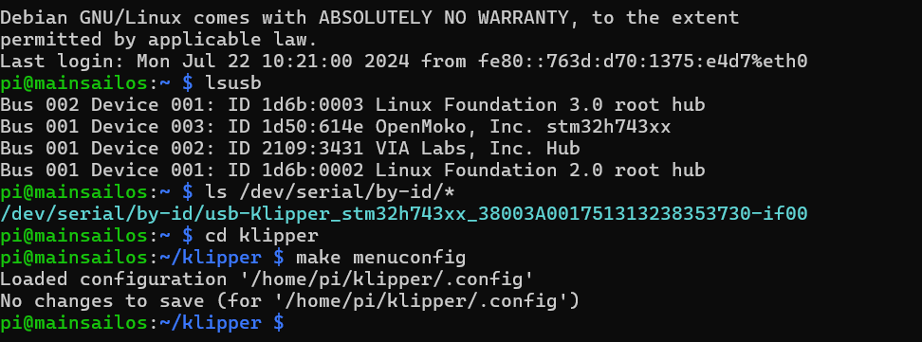
lsusb

Slide 5
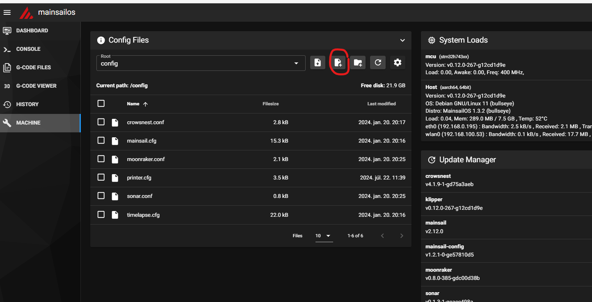
Create printer.cfg-t in mainsail

Slide 6
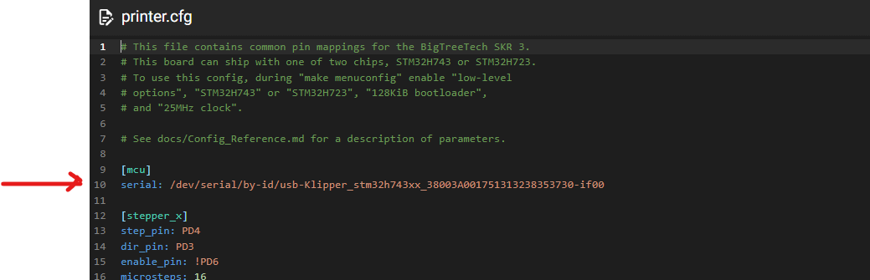
Copy usb address to printer.cfg

Slide 7
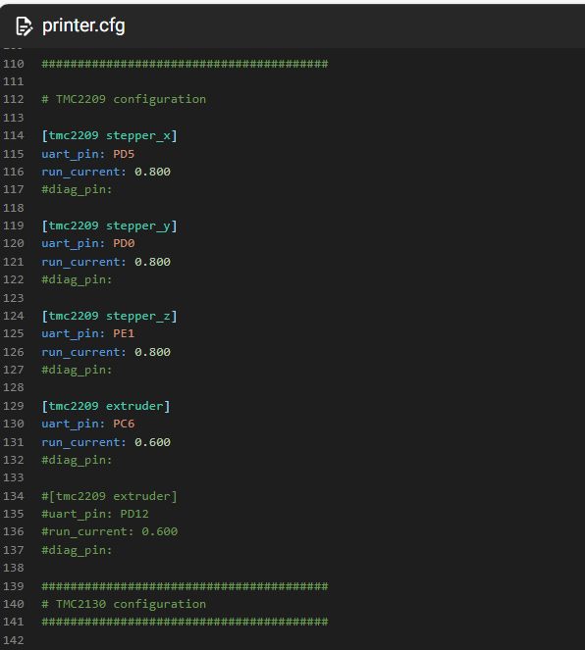
Enable TMC2209 in printer.cfg

Slide 8
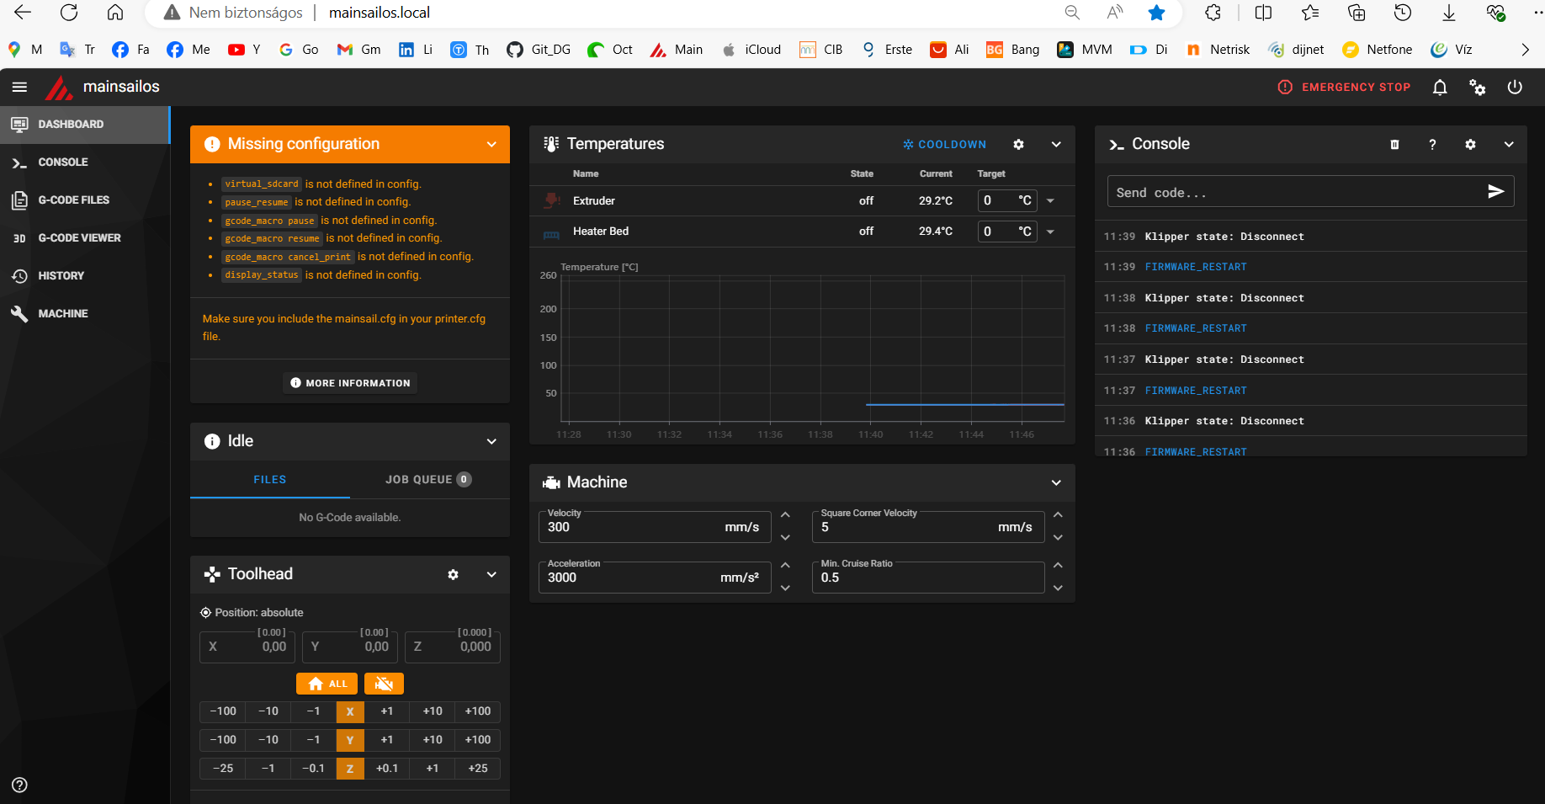

Slide 9
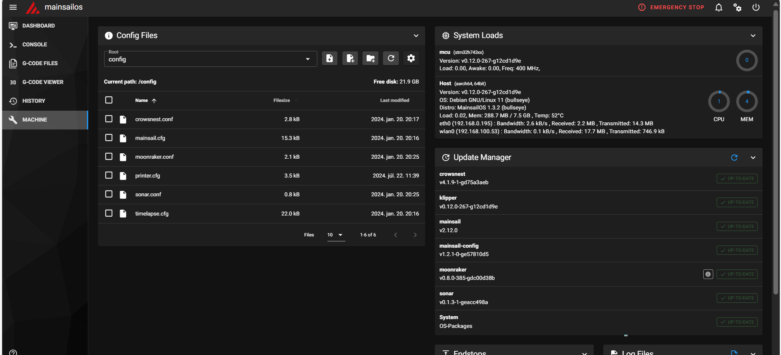

Slide 10
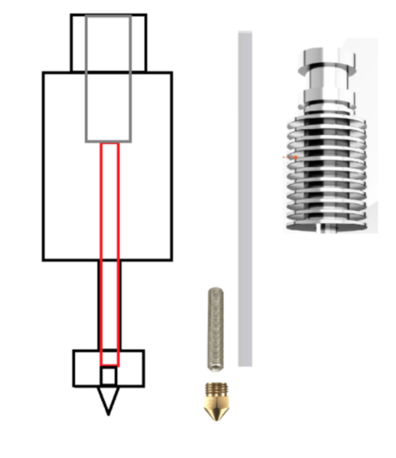
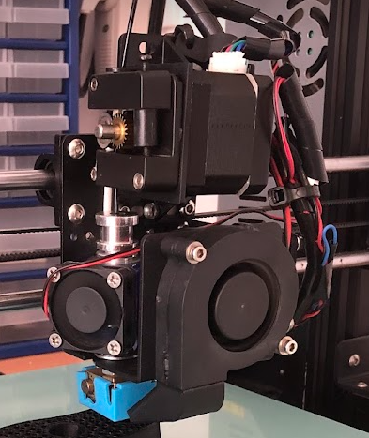

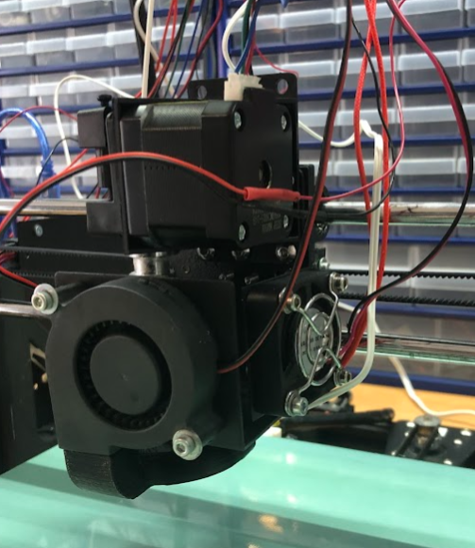

Volcano V6 extruder

Slide 11
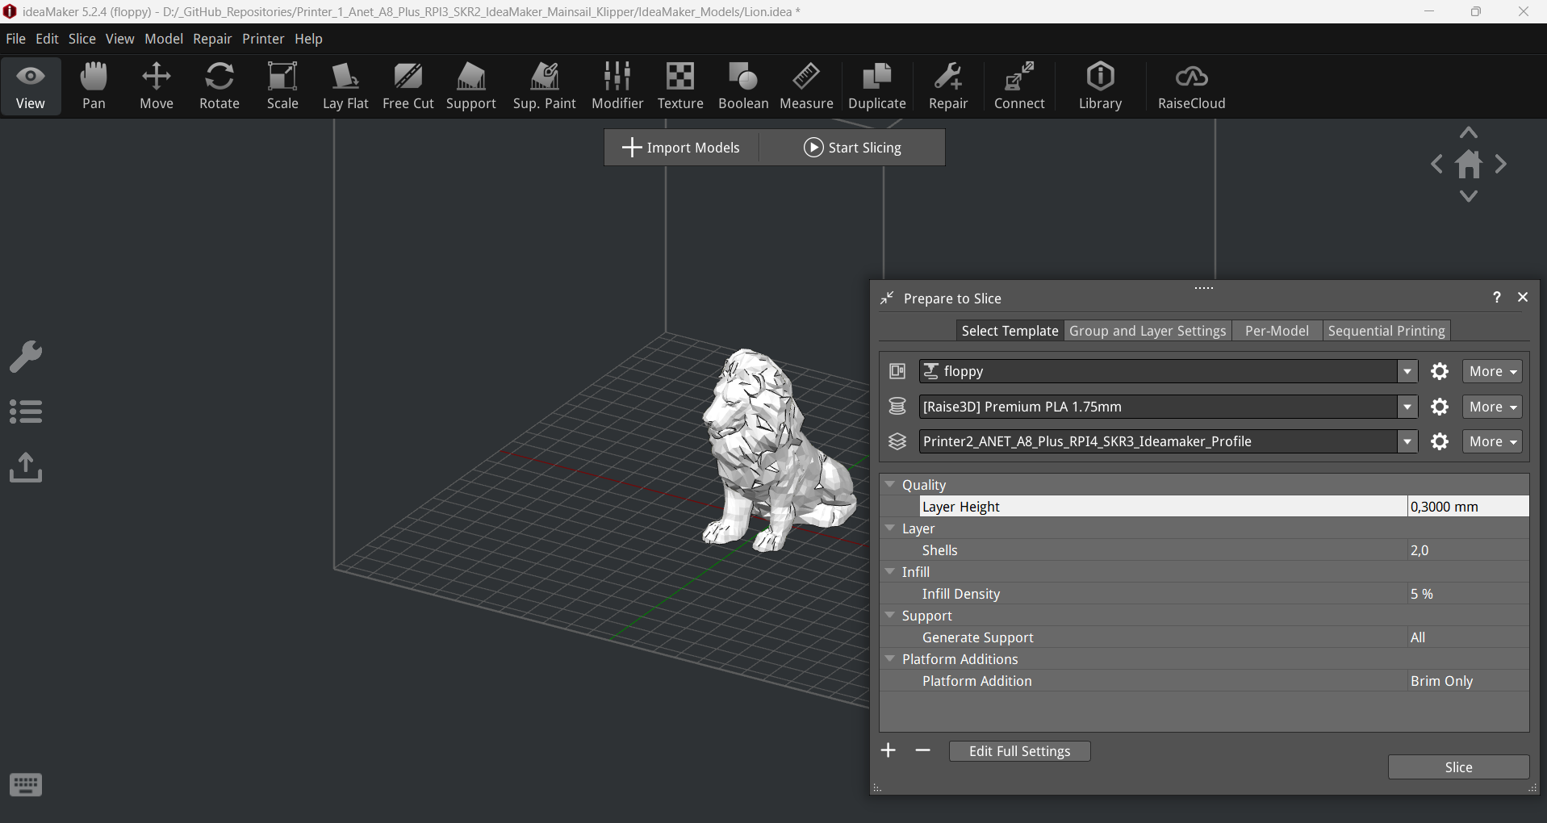
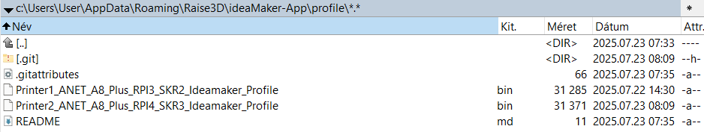
IdeaMaker Profile

